Slide 1
XYZ marketing campaign conversion forecast
By Xiaowen, Nick, and Yuzy

Slide 2
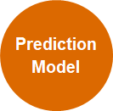
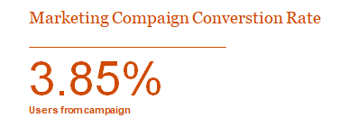



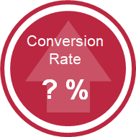
Introduction
Premium Users
Campaign Targets
Marketing managers may better optimize & allocate costs to the promotional campaign
Free Users
Notes:
This is the percentage conversion without targeting groups

Slide 3
Problem & Solution
+8.15%
-82%
Adoption Rate
Campaign Cost
Conversion rate was low last promotional campaign, due to low reach of high-potential groups.
Previously, promotional campaigns were rolled out without targeting non-subscribers with more potential, leading to potential over spending.
Model can predict customers, based on features, with higher potential conversion rates
Reduce unnecessary reachout
Some customers will likely not respond even if targeted

Slide 4

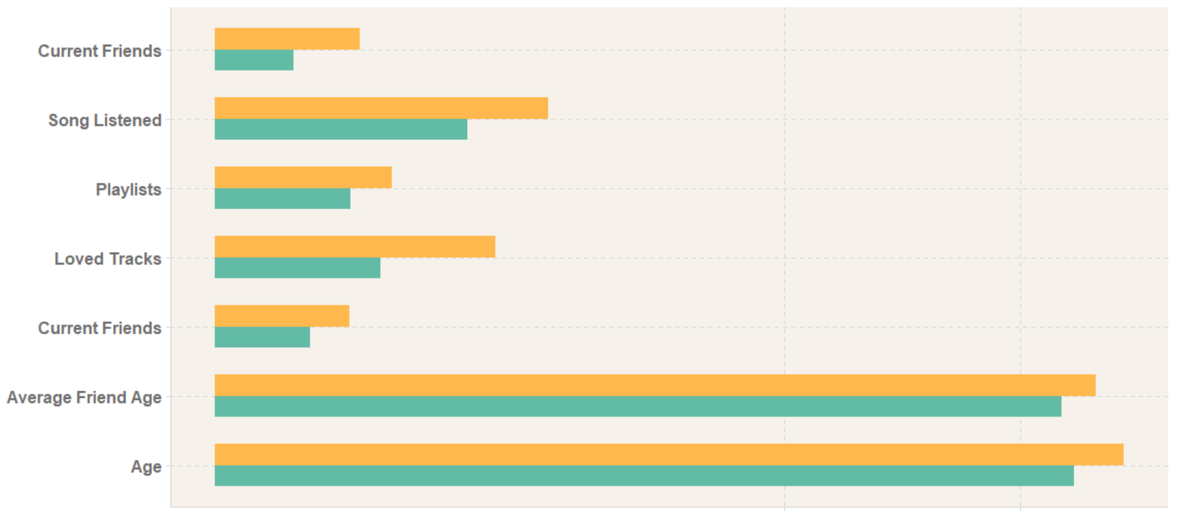


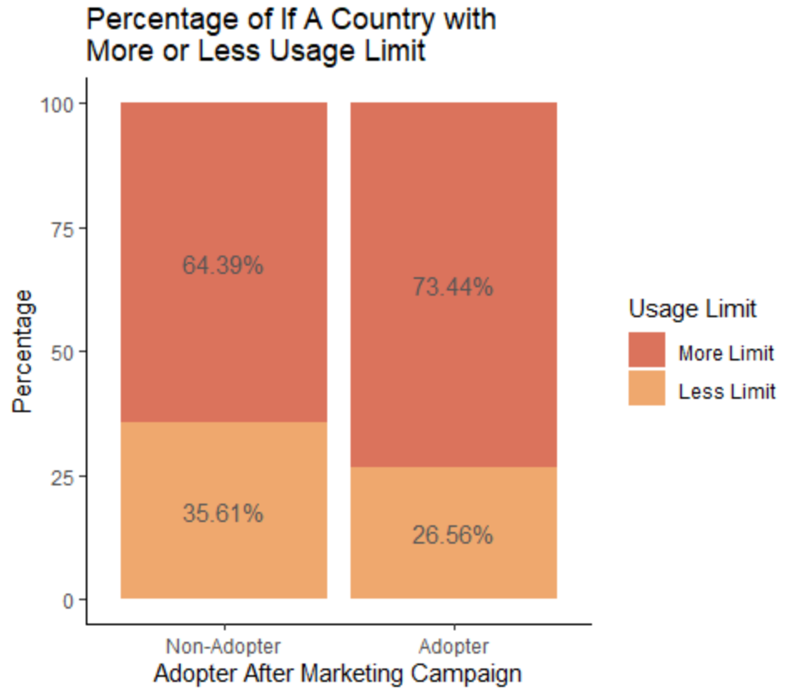
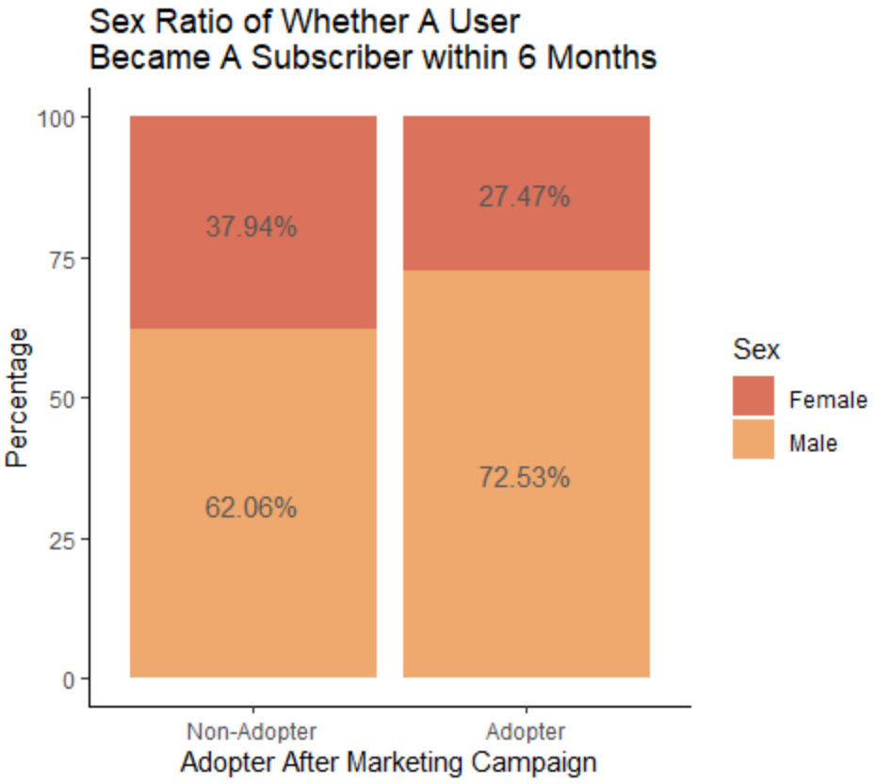


Understanding the Data
Data Source
Data regarding users of XYZ website targeted in the previous marketing campaign
Data Feature
25 attributes were collected from the previous marketing campaign
Data Type
2 data types were included in database: binomial and numeric data
Our Selection
Some data are clearly different between adopters and non-adopters

Slide 5
Modeling, Predictions and Interpretation

Slide 6



Metric Selection
Accuracy measures all correct predictions for both positive and negative results.
Recall measures the correct predictions for all positive results
Precision measures the correct predictions among all predictions
F-measure is in between the precision and recall
Accuracy: 0.50
Recall: 0.33
Precision: 0.25
F-Measure: 0.28

Slide 7
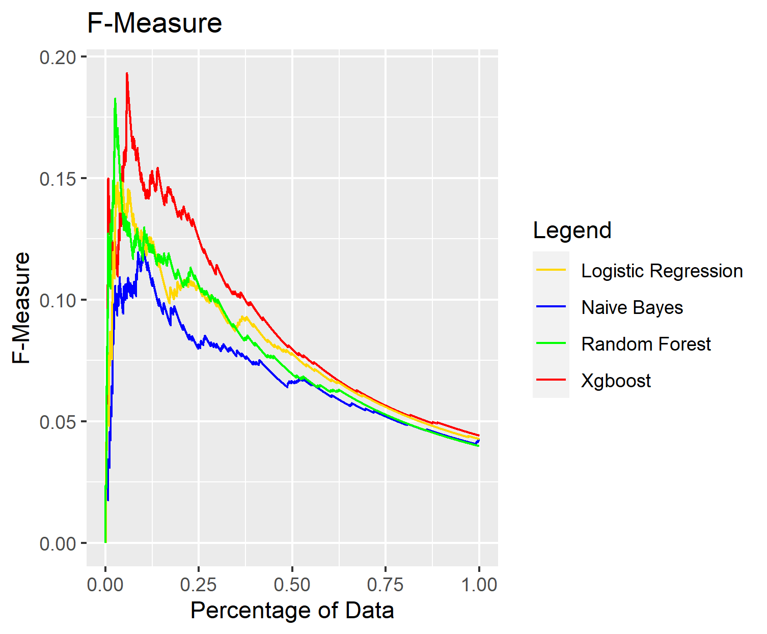
Predictions and Interpretation
Logistic Regression
Naive Bayes
Random Forest
Xgboost
Interoperability Efficient
Easy Quick Less Accurate
Accurate Lack Interpretability
Accurate Quick Lack Interpretability

Slide 8
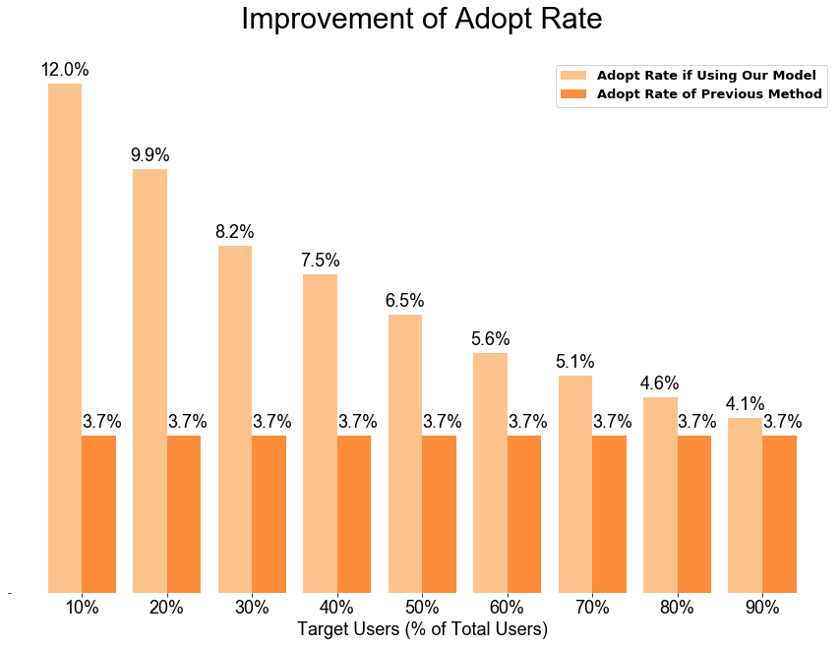
Impact & Value
Choose appropriate % of Target Users depending on the market campaign budget
Improve conversion rate by up to 8.15% in next campaign compared to previous campaign

Slide 9
Conclusions and Next Step

